Slide 1
Affordable & Available: Large Scale Clean Energy for New England
April 17, 2015

Slide 2
Executive Summary
Renewable energy supply is affordable, abundant and available - and the market is ready to deliver
Procurement at scale will deliver savings to energy consumers
Delivering this quantity of energy will require new transmission

Slide 3
Introduction to SunEdison
NYSE: SUNE
Fortune 1000
~$6 billion market cap
2,700 employees, 20+ locations worldwide
Developer, asset owner and solar materials for GP-like business model
First Wind acquisition closed Jan. 2015
Paul Gaynor leads NA Utility and Global Wind
~50%
~26%
Emerging Markets Yieldco
Future Ownership Vehicles
NASDAQ: TERP
~$4.3 billion market cap
1,507 MW operating
Stated 24% DPS growth
OECD focus
Call right projects from SUNE and M&A provide platform for future growth
In formation
Emerging high growth markets, non-OECD focus
By region, country and/or market segment, e.g. India Utility, or UK Residential, etc.
Deconsolidated 1Q 2015
Likely to divest remaining stake
World’s Largest Renewable Energy Developer

Slide 4
Meeting New England Energy Challenges
Demand
Supply
Region is challenged by a lack of natural gas pipeline and electricity transmission infrastructure, resulting in reliability and cost issues
According to ISO-NE, additional energy infrastructure (generation, transmission, gas pipeline, fuel storage) is needed
Retirements of coal- and oil-fired units, and a nuclear unit; replacements by natural gas… energy mix losing diversity
Currently, Class 1 REC deficit
Compliance with environmental and clean energy requirements will need additional clean energy resources
MA Global Warming Solutions Act
US EPA 111(d) Clean Power Plan
MA Renewable Portfolio Standard
SunEdison’s pipeline can deliver incremental 5+ TWh wind energy
Large surplus of Canadian hydro
Several new large projects under construction
Opportunities to provide blended/firm clean energy
Current Multi-State RFP contemplates innovative transmission procurement structures

Slide 5
Supply is Available, Market Will Deliver
SunEdison’s pipeline could deliver an incremental
~2 GW capacity or 5.1 TWh energy by 2020
SunEdison New England Development Pipeline Anticipated Delivery (TWh)
2017 2018 2019 2020
SunEdison supply supplements other incremental clean energy resources

Slide 6
Large Scale Procurement = Consumer Savings
Procurement Principles
Competition, scale, and long (30 year) duration results in best price
Long-term PPAs for renewable power have been a success in New England, with significant consumer savings
Most recent MA results: Consumer savings of ~$200 million per 100 MW wind contracted over the life of the PPAs
Legislation authorizing future procurement could result in $1 billion per year savings for Massachusetts ratepayers
In addition to savings, other benefits include increasing system diversity and addressing climate & RPS compliance challenges
Note: Savings from existing PPAs were estimated by the MA utilities and reviewed by the DPU.
Estimates of future savings are SunEdison’s analysis of H. 2861 based on an ISO-NE study.

Slide 7
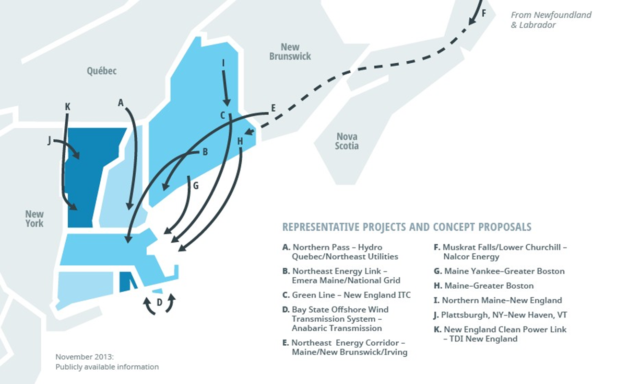
Proposed Transmission Resources
Image Source: ISO-New England

Slide 8
Matt Kearns
VP, North America Development
mkearns@sunedison.com

